Slide 1
CPU INSTRUCTION CYCLE
LECTURE: 5

Slide 2
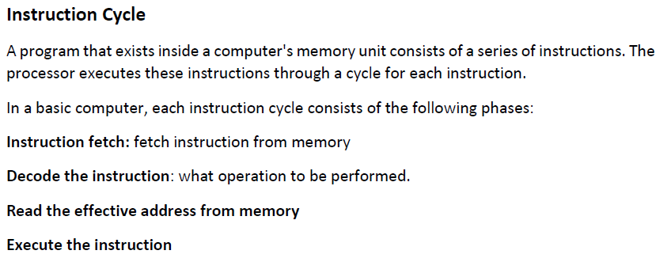
INSTRUCTION CYCLE

Slide 3
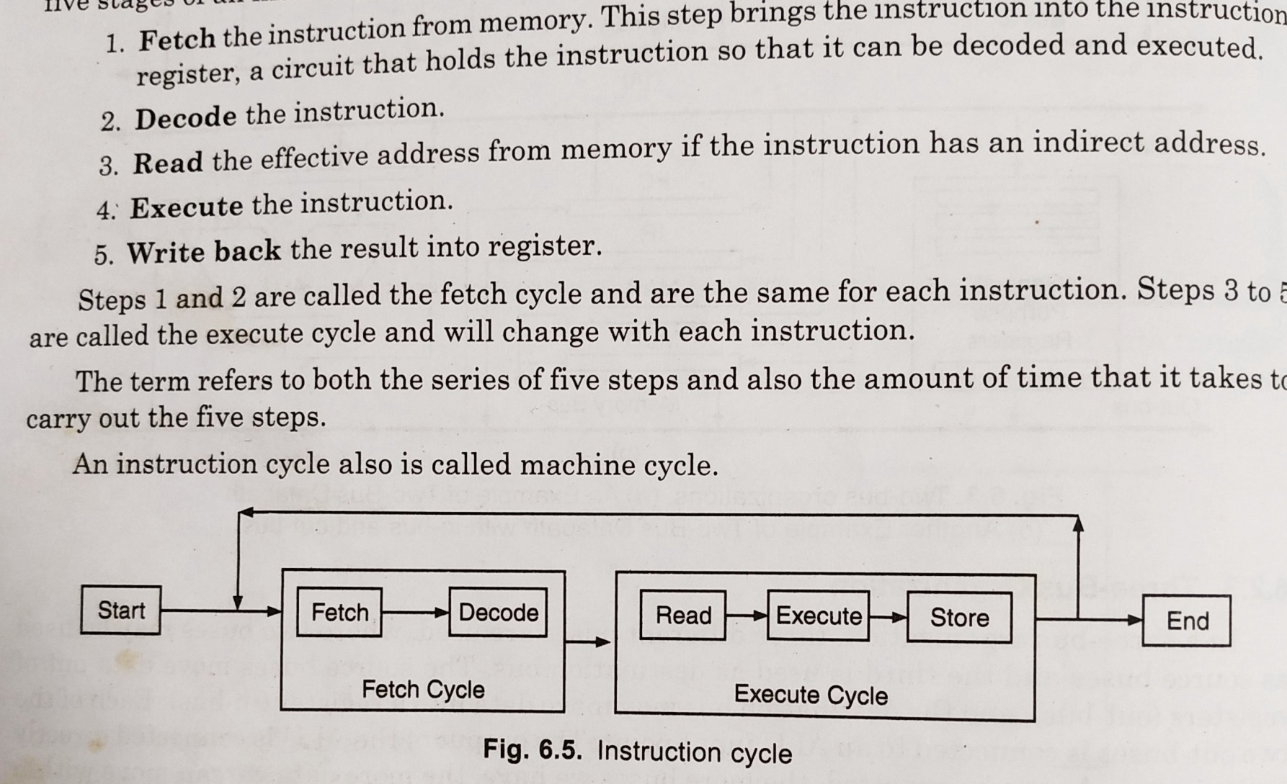
INSTRUCTION CYCLE

Slide 4
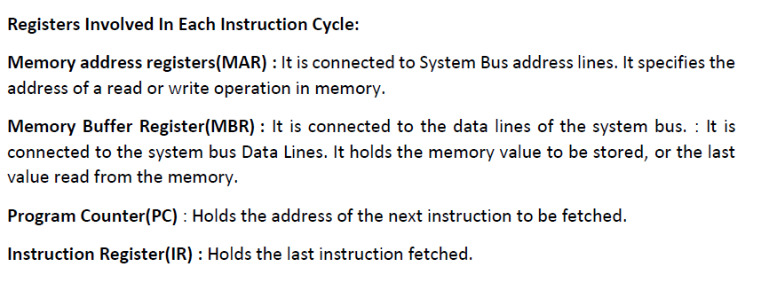
INSTRUCTION CYCLE

Slide 5
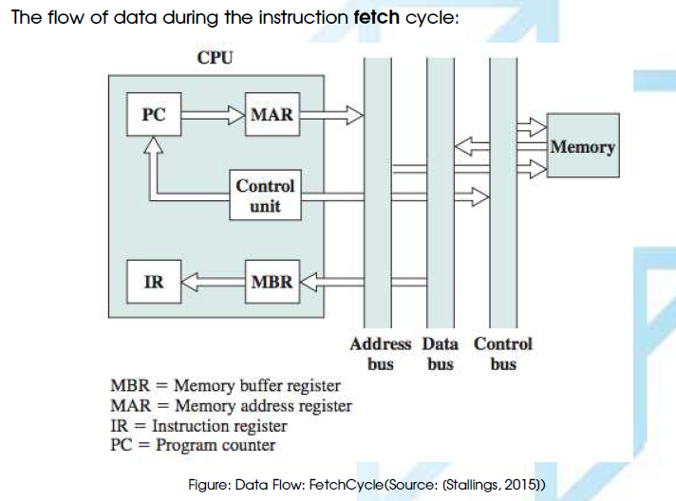
FETCH CYCLE

Slide 6
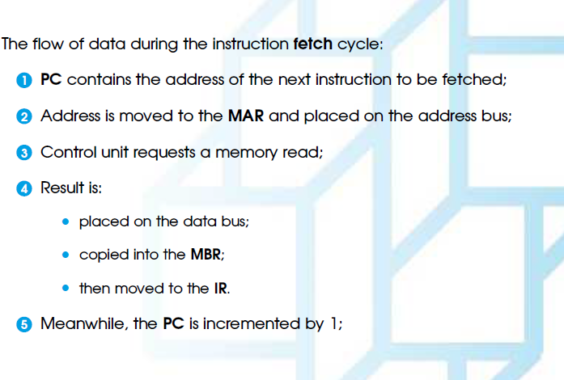
FETCH CYCLE

Slide 7
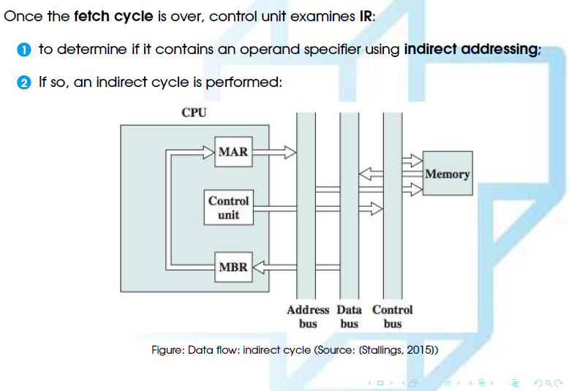
FETCH CYCLE

Slide 8
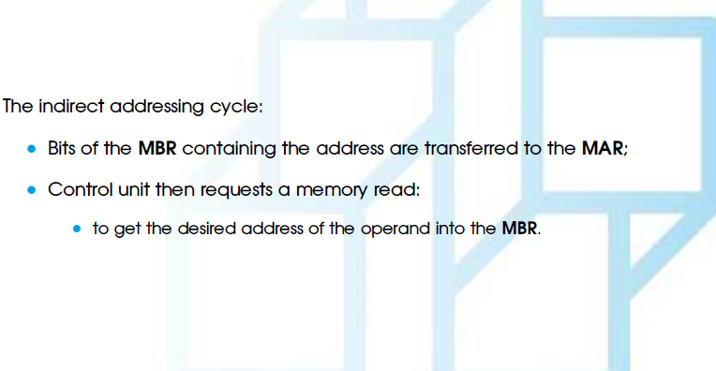
FETCH CYCLE

Slide 9
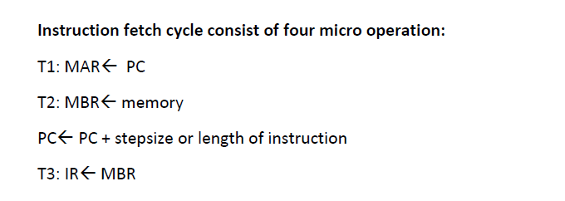
FETCH CYCLE

Slide 10
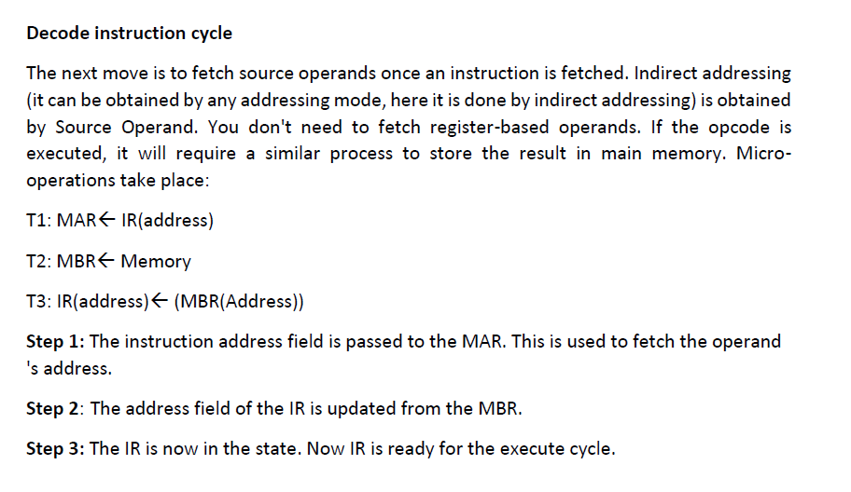
DECODE INSTRUCTION CYCLE

Slide 11
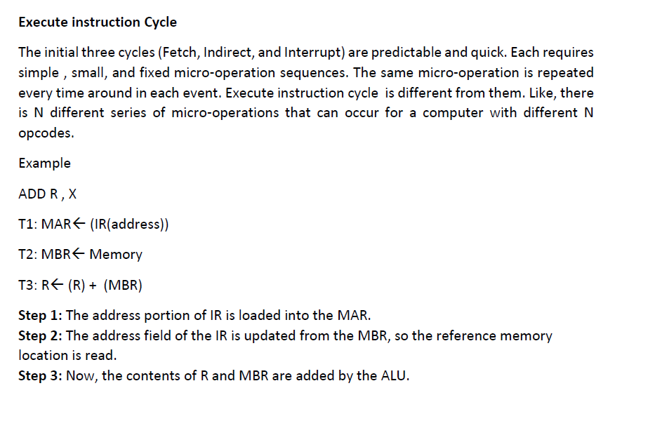
EXECUTE INSTRUCTION CYCLE

Slide 12
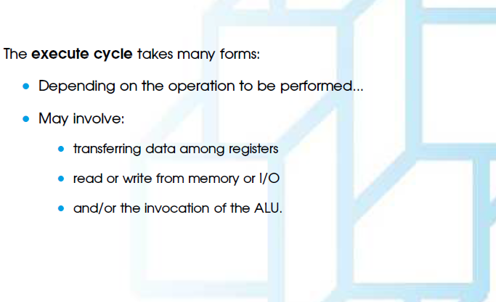
EXECUTE INSTRUCTION CYCLE

Slide 13
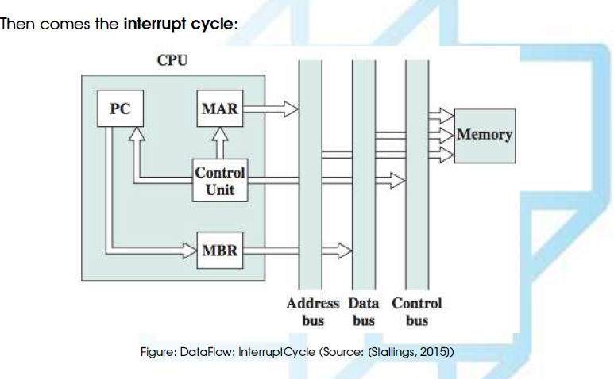
INTERRUPT CYCLE

Slide 14
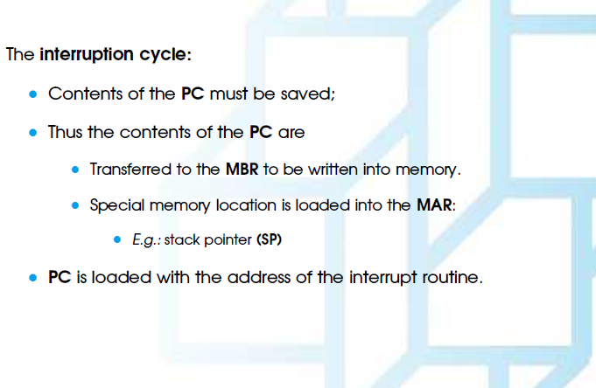
INTERRUPT CYCLE

Slide 15
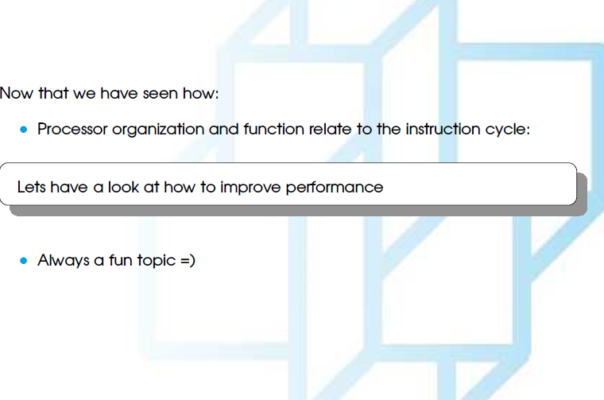
IMPROVE PERFORMANCE

Slide 16
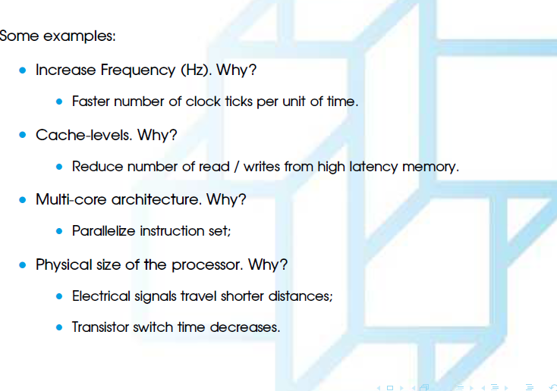
IMPROVE PERFORMANCE

